Slide 1


IOT-BASED WEATHER MONITORING SYSTEM
Experiment 3
Raphael S. Nano
CPE162P / C1
Computer Engineering Department
School of Electrical, Electronics, and Computer Engineering

Slide 2
Introduction: IoT-based Weather Monitoring System
These systems serve as a hub for meteorological knowledge by continuously monitoring and predicting weather patterns
They offer a wide variety of analysis for weather reports using a network of sensors and grounded measurement tools

Slide 3
Objectives
To demonstrate how an IoT based weather monitoring system works.
To be able apply what you have learned in logic circuits and switching theory, microprocessors, CPE160P, and CPE161P.
To be able to apply embedded system with IoT using Arduino kit
To be able to use ThingSpeak for the data collection and analysis.

Slide 4
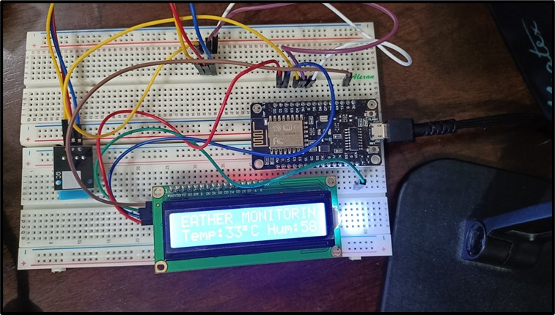
Materials
Hardware
ESP8266 WiFi Module
DHT11 Temperature and Humidity Sensor
Liquid Crystal Display
Notes:
The materials utilized to construct the real-time basketball scoreboard are the Arduino UNO, the 4-digit seven segment display, and 5 switch buttons.

Slide 5
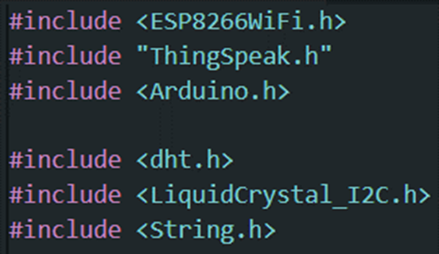
Materials
Software Libraries
ESP8266WiFi.h
ThingSpeak.h
dht.h
LiquidCrystal_I2C.h

Slide 6
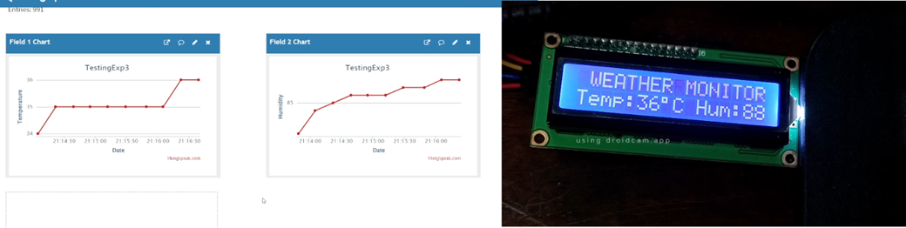
Discussion: IoT-based Weather Monitoring System
Goal is to build a system that streams temperature and humidity data over the internet to the user
ThingSpeak will be used for graphing of values

Slide 7
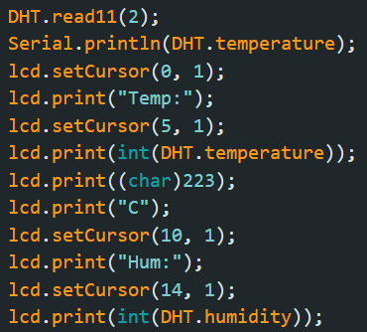
Discussion: IoT-based Weather Monitoring System
Detection of temperature and humidity and the displaying of values in the LCD
read11(): the DHT detects the temperature and humidity
lcd.print(): output the value of the DHT in LCD

Slide 8
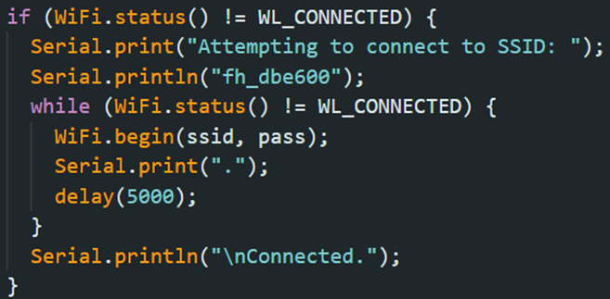
Discussion: IoT-based Weather Monitoring System
A WiFi connection was first established in order to be able to connect the ESP8266 and the ThingSpeak
A code was again created, wherein it connect to a certain network via Wi-Fi (fh_dbe600) and makes multiple attempts until an adequate connection is established.

Slide 9
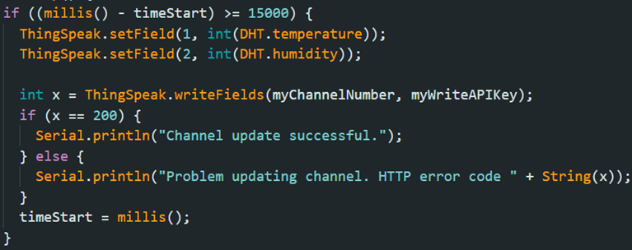
Discussion: IoT-based Weather Monitoring System
For the updating of the fields in ThingSpeak, it occurs every 15 seconds
There are two fields: one for temperature and one for humidity
The updating of the values is done using the writeFields function

Slide 10
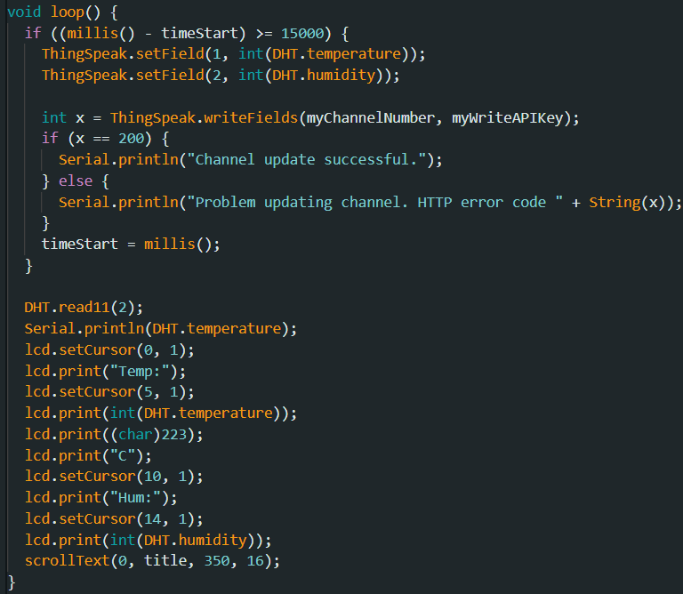
Discussion: IoT-based Weather Monitoring System
The detection of the temperature and humidity using DHT11 is continuous
The updating of the output in ThingSpeak is every 15 seconds

Slide 11
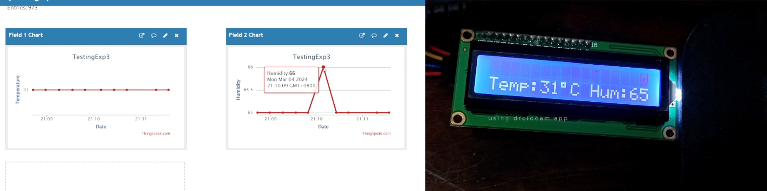
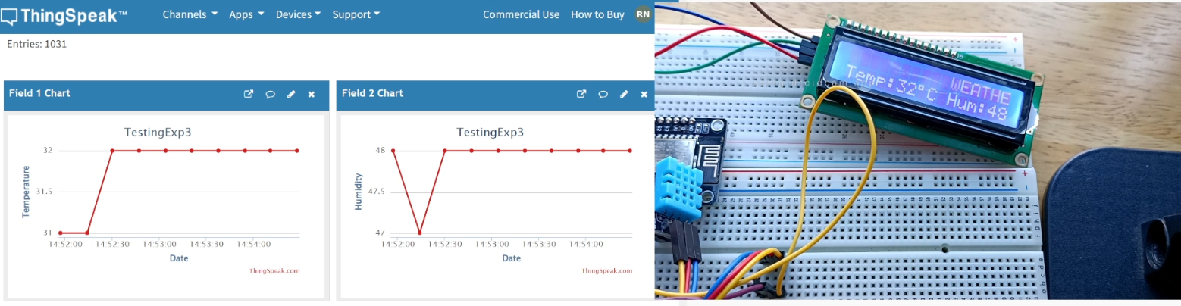
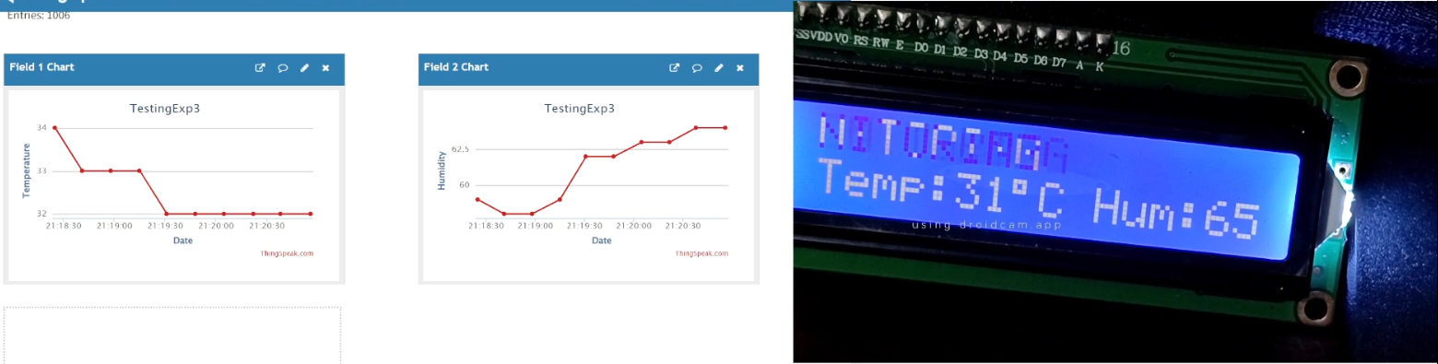
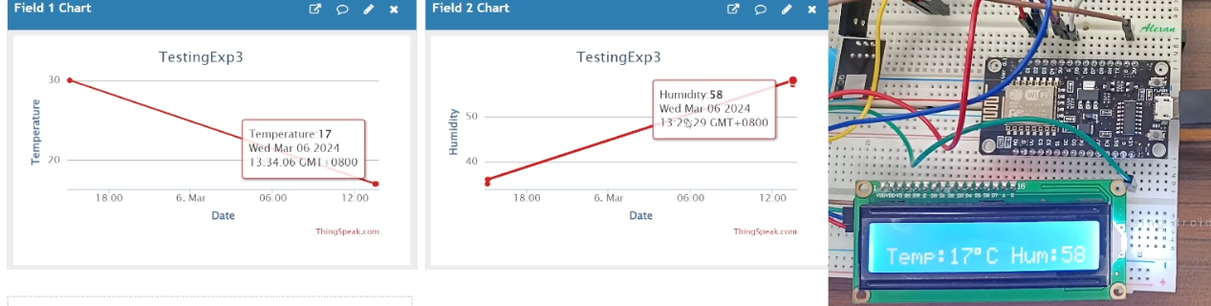

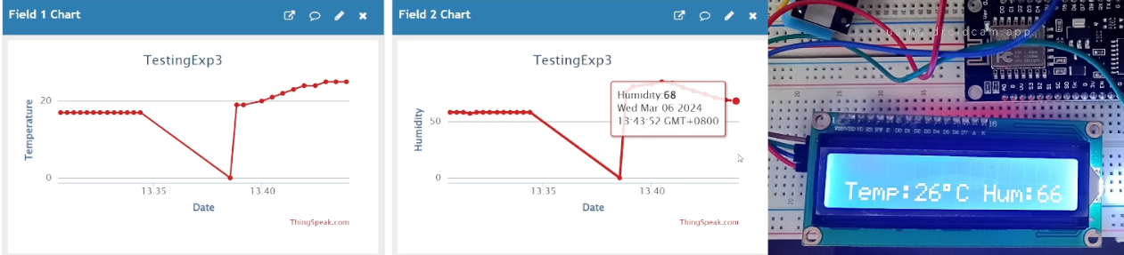
Results: IoT-based Weather Monitoring System

Slide 12
Conclusion
The IoT-based Weather Monitoring System functions by:
  utilizing the read11() and lcd.print() function
  the temperature and humidity is printed on the LCD
  Every 15 seconds, the ThingSpeak is being updated

Slide 13
Conclusion
The second objective was achieved by:
  using the Arduino IDE codes in order to connect the ESP8266 with ThingSpeak
  applying the libraries for the sensor
The ThingSpeak successfully displays the temperature and humidity values every 15 seconds, which was adequately performed by using the writeFields() function
The IoT-based Weather Monitoring System was successfully created, wherein the values are accurate and the outputs are understandable both in the LCD and in ThingSpeak.

